Slide 1

Dept. of Computer Science and Engineering
University of Rajshahi
www.ru.ac.bd
Dr. Shamim Ahmad

Slide 2
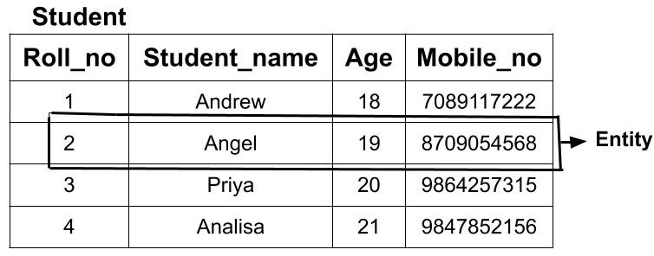

Slide 3
Super key: any set of attributes such that the values of the
attributes (taken together) uniquely identify one entity in the
entity set
_ For example, HKID, SID, {NAME, SID}.
_ Candidate key: Minimal super key -- a super key with no
redundant attributes
_ For example, HKID, SID.
_ Primary key: A primary key is one of the candidate keys,
designated by the database designer
_ For example, SID.
_ Every primary key is also a candidate key; every candidate key is also a super key, but not vice versa

Slide 4
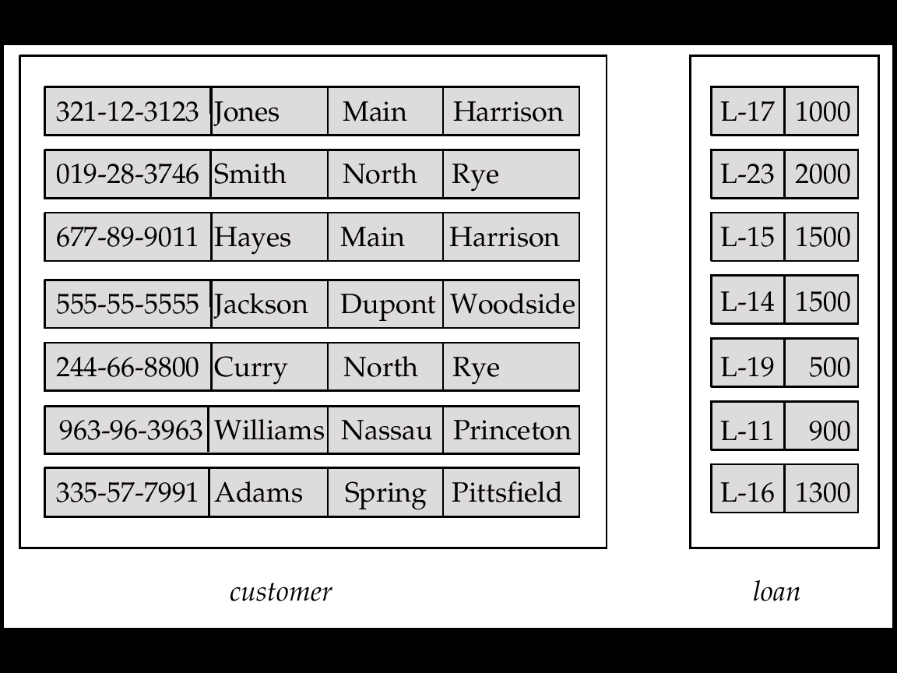
Entity Sets customer and loan
customer-id customer- customer- customer- loan- amount name street city number

Slide 5
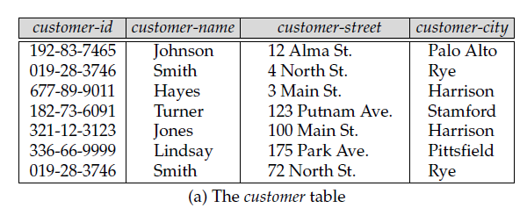
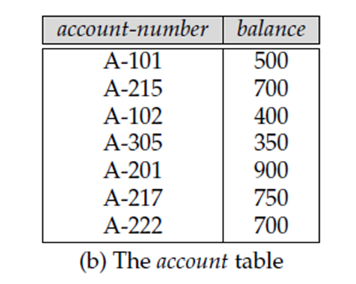

Slide 6
Basic Concepts (Cont.)
Relationship Sets
A relationship is an association among several entities
Example: Hayes depositor A-102 customer entity relationship set account entity
A relationship set is a mathematical relation among n ≥ 2 entities, each taken from entity sets
{(e₁, e₂, … e_{n}) | e₁ ∈ E₁, e₂ ∈ E₂, …, e_{n} ∈ E_{n}} where (e₁, e₂, …, e_{n}) is a relationship

Slide 7
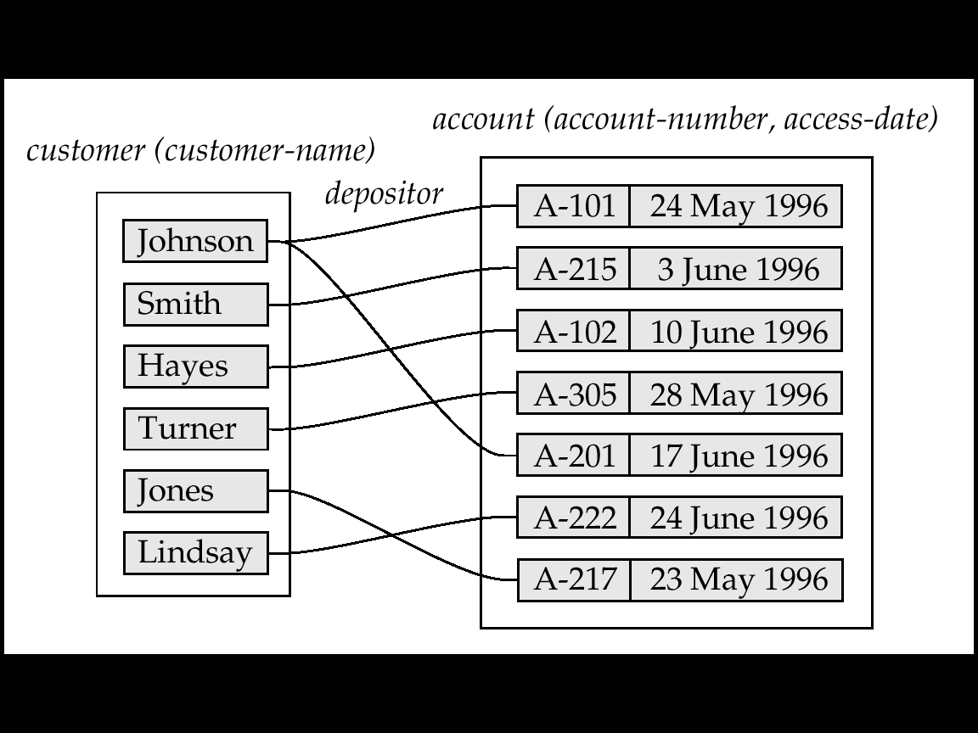
Example: (Hayes, A-102) ∈ depositor

Slide 8
Example: (Hayes, A-102) ∈ depositor

Slide 9
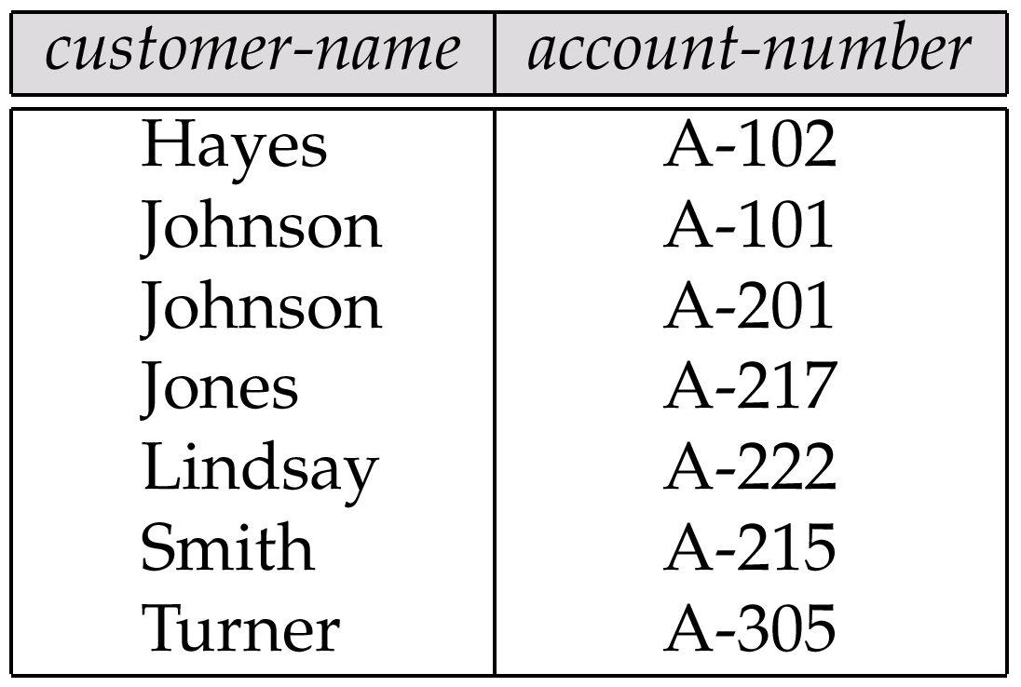
The depositor Relation

Slide 10
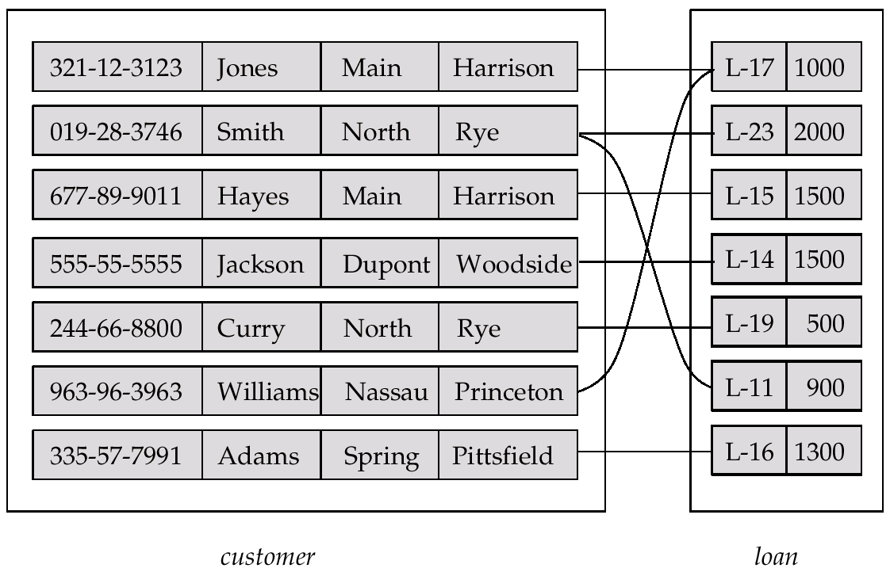
Relationship Set borrower

Slide 11
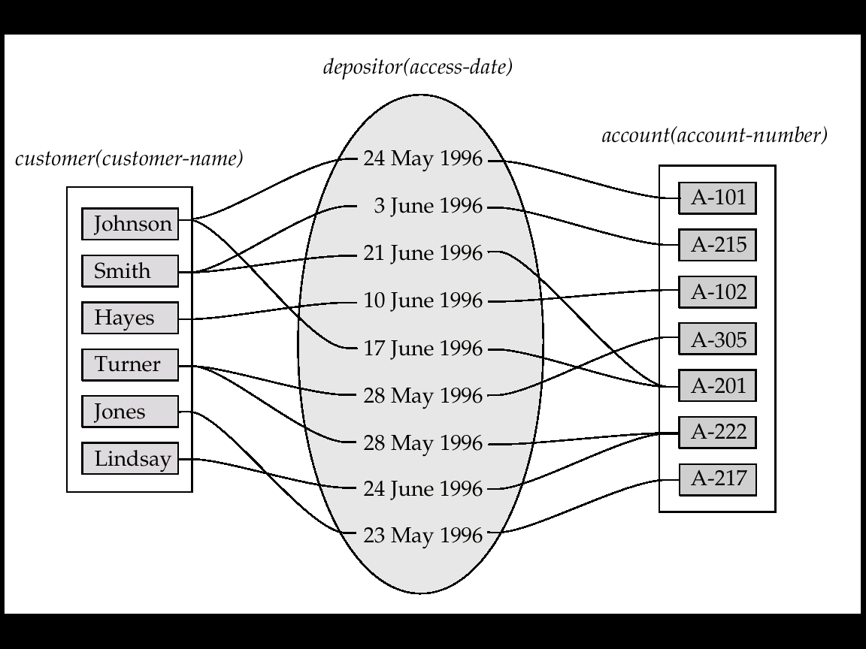
Basic Concepts(Cont.)
An attribute can also be property of a relationship set.
For instance, the depositor relationship set between entity sets customer and account may have the attribute access-date

Slide 12
The association between entity sets is referred to as participation;
that is,
the entity sets E1, E2, . . .,En
participate in relationship set R.

Slide 13
A relationship instance
in an
E-R schema =>
A association between
the named entities in
the real-world enterprise
that is being modeled.

Slide 14
Example
the person called Hayes who
Lives in City Harison
in Main Street
Has taken the loan

Slide 15
Example
the person called Hayes who
Lives in City Harison
in Main Street
Has taken the loan
Does he have any ID?
Yes, Customer-id 677-89-9011

Slide 16
Example
the person called Hayes who
Lives in City Harison
in Main Street
Has taken the loan
Does he have any ID?
Yes, Customer-id 677-89-9011
Any Load Identification?
Yes, Loan is numbered L-15.

Slide 17
Role:
The function that an entity plays in a relationship is called that entity’s role.
Roles are implicit
They are not usually specified.
When Required?
The same entity set participates in a relationship set more than once,

Slide 18
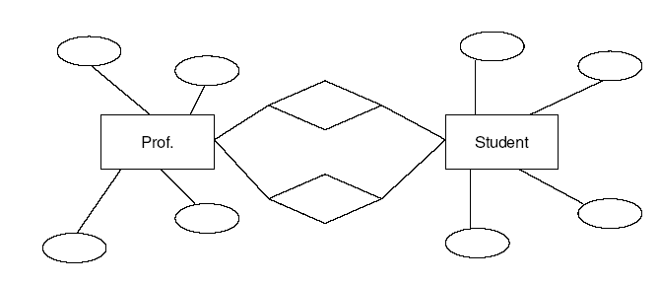
Role: Recursive Relationship
Manager
Employee
Employee
Worker
A relationship Set
works-for
that is modeled by
ordered pairs of employee entities

Slide 19
Basic Concepts(Cont.)
Degree of a Relationship Set
Refers to number of entity sets that participate in a relationship set.
Relationship sets that involve two entity sets are binary (or degree two). Generally, most relationship sets in a database system are binary.
Relationship sets may involve more than two entity sets.
Relationships between more than two entity sets are rare. Most relationships are binary. (More on this later.)
E.g. Suppose employees of a bank may have jobs (responsibilities) at multiple branches, with different jobs at different branches. Then there is a ternary relationship set between entity sets employee, job and branch

Slide 20
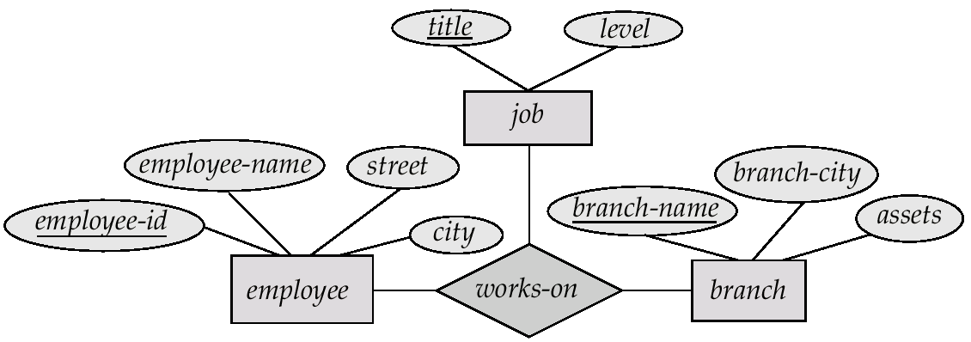
E-R Diagram with a Ternary Relationship

Slide 21
Constraints
Mapping Cardinalities
Express the number of entities to which another entity can be associated via a relationship set.
Most useful in describing binary relationship sets.
For a binary relationship set the mapping cardinality must be one of the following types:
One to one
One to many
Many to one
Many to many

Slide 22
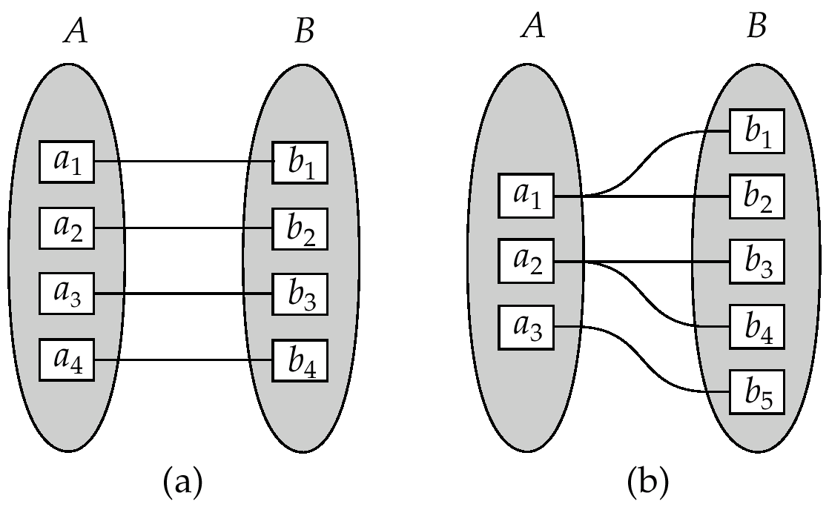
Constraints (Cont.)
One to one
One to many
Note: Some elements in A and B may not be mapped to any
elements in the other set

Slide 23
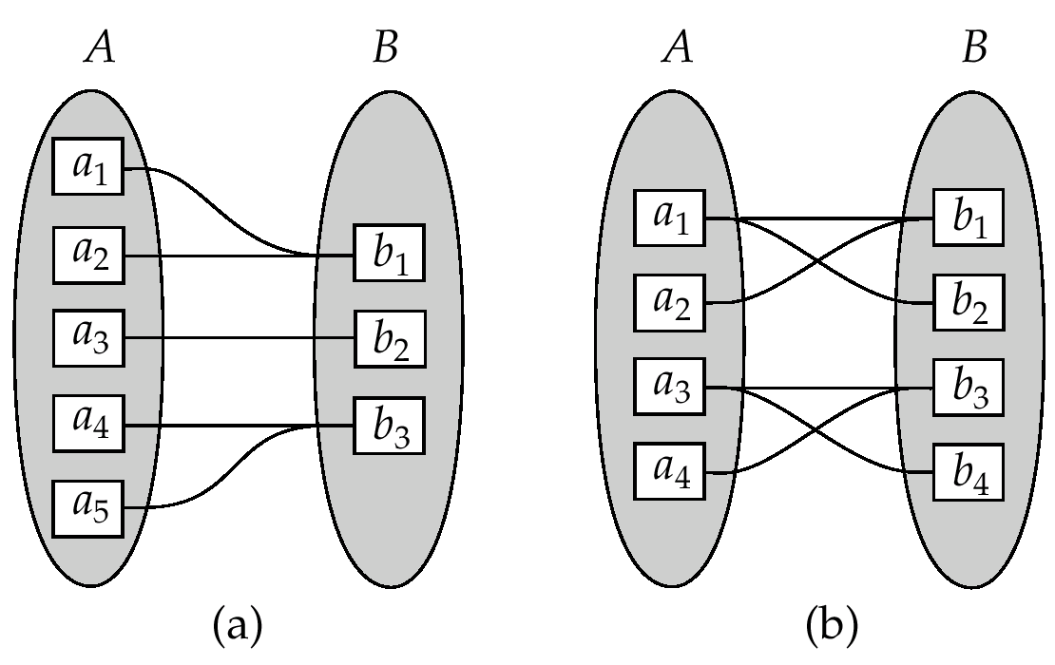
Constraints (Cont.)
Many to one
Many to many
Note: Some elements in A and B may not be mapped to any
elements in the other set

Slide 24
Constraints (Cont.)
Participation Constraints
The participation of an entity set E in a relationship set R is said to be total if every entity in E participates in at least one relationship in R.
For example, we expect every loan entity to be related to at least one customer through the borrower relationship.
If only some entities in E participate in relationship in R, the participation of entity set E in relationship R is said to be partial.
For example, the participation of customer in the borrower relationship set is therefore set is therefore partial.
চিহ্ণতকরণকে
চিহ্ণতকরণকে

Slide 25
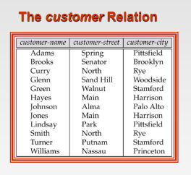
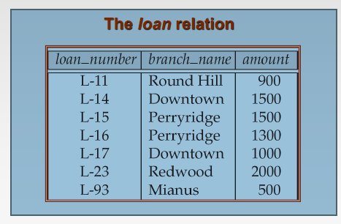

Slide 26
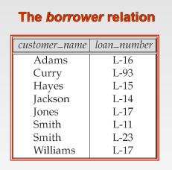

Slide 27
Keys
Entity Sets
A super key of an entity set is a set of one or more attributes whose values uniquely determine each entity.
A candidate key of an entity set is a minimal super key
Customer-id is candidate key of customer
account-number is candidate key of account
Although several candidate keys may exist, one of the candidate keys is selected to be the primary key.

Slide 28
Relationship Sets
The combination of primary keys of the participating entity sets forms a super key of a relationship set.
primary-key(E1) ∪ primary-key(E2) ∪ · · · ∪ primary-key(En)
describes an individual relationship in set R.
primary-key(E1) ∪ primary-key(E2) ∪ · · · ∪ primary-key(En) ∪ {a1, a2, . . . , am}

Slide 29
Keys (Cont.)
(customer-id, account-number) is the super key of depositor
NOTE: this means a pair of entity sets can have at most one relationship in a particular relationship set.
E.g. if we wish to track all access-dates to each account by each customer, we cannot assume a relationship for each access. We can use a multivalued attribute though
Must consider the mapping cardinality of the relationship set when deciding the what are the candidate keys
Need to consider semantics of relationship set in selecting the primary key in case of more than one candidate key

Slide 30
It is possible
To define a set of entities and the relationships
In a number of different ways

Slide 31
Example:
Case 1:
employee (employee-name, telephone-number)
Case 2:
employee (employee-name)
telephone (telephone-number,location)
Relationship set emp-telephone(association between employees and the telephones that they have)
*An employee may have Multiple/None telephone
Case 3: ?
Employee’s name as an Entity?

Slide 32
Entity Sets versus Attributes
Entity Sets versus Relationship Sets

Slide 33
Entity Sets versus Attributes
What constitutes an attribute, and
what constitutes an entity set?
Unfortunately, there are no simple answers
It depends on:
The structure of the real-world enterprise being modeled
The semantics associated with the attribute in question.

Slide 34
Common Mistakes:
Primary key of an entity set as an attribute of another
entity set.
Example: To model customer-id as an attribute of loan even if each loan had only one customer

Slide 35
Entity Sets versus Relationship Sets
It is not always clear whether
an object is best expressed by
an entity set
or
a relationship set.

Slide 36
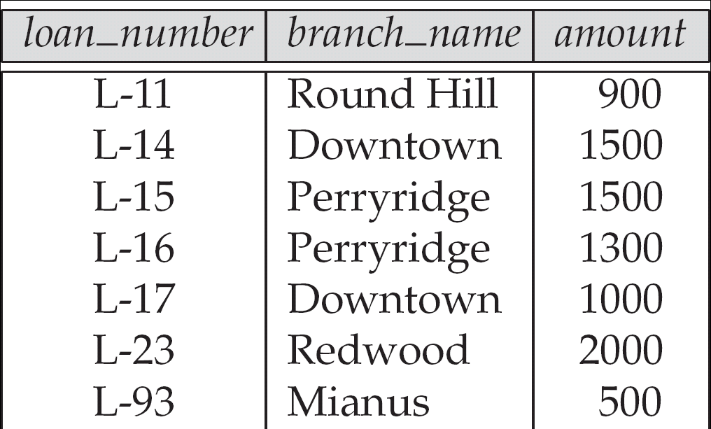
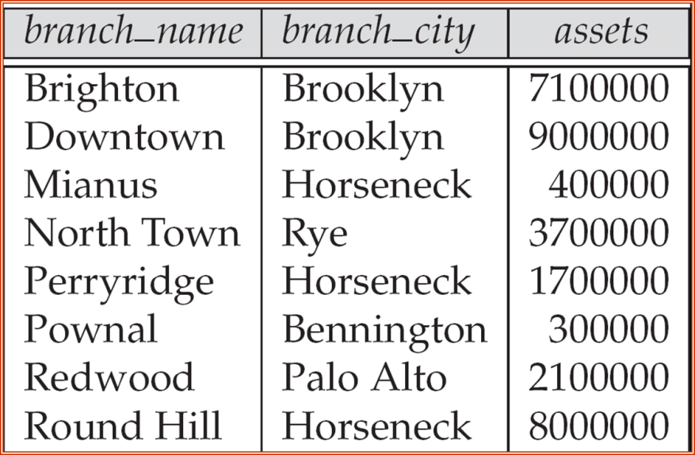

The loan relation

Slide 37
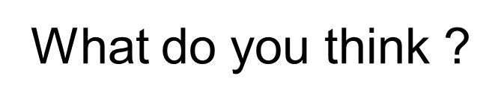
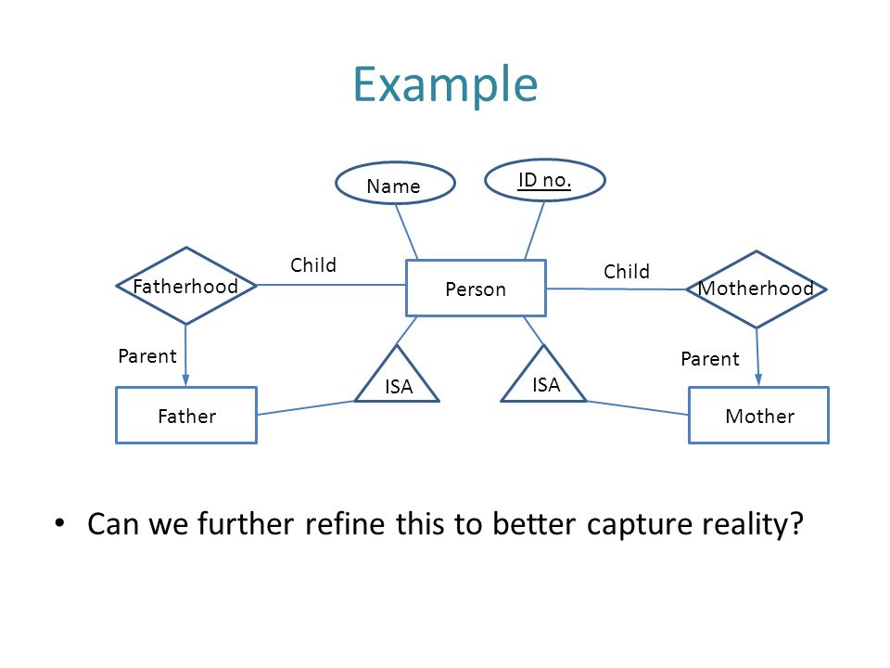

Slide 38
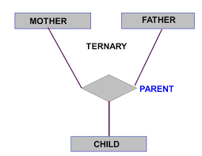

Slide 39

Binary Relationships
If there are two entity types involved it is a binary relationship type

Slide 40

Ternary relationship
If there are three entity types involved it is a ternary relationship type

Slide 41
Replacing ternary relationships
When ternary relationships occurs in an ER model they should always be removed before finishing the model.
Sometimes the relationships can be replaced by a series of binary relationships that link pairs of the original ternary relationship.

Slide 42

Replacing ternary relationships (Cont)
This can result in the loss of some information - It is no longer clear which sales assistant sold a customer a particular product.
Try replacing the ternary relationship with an entity type and a set of binary relationships.

Slide 43

Replacing ternary relationships (Cont)
Relationships are usually verbs, so name the new entity type by the relationship verb rewritten as a noun.
The relationship sells can become the entity type sale.
So a sales assistant can be linked to a specific customer and both of them to the sale of a particular product.
This process also works for higher order relationships.

Slide 44
E-R Diagram with a Ternary Relationship

Slide 45
E-R Diagrams
Rectangles represent entity sets.
Diamonds represent relationship sets.
Lines link attributes to entity sets and entity sets to relationship sets.
Ellipses represent attributes
Double ellipses represent multivalued attributes.
Dashed ellipses denote derived attributes.
Underline indicates primary key attributes

Slide 46
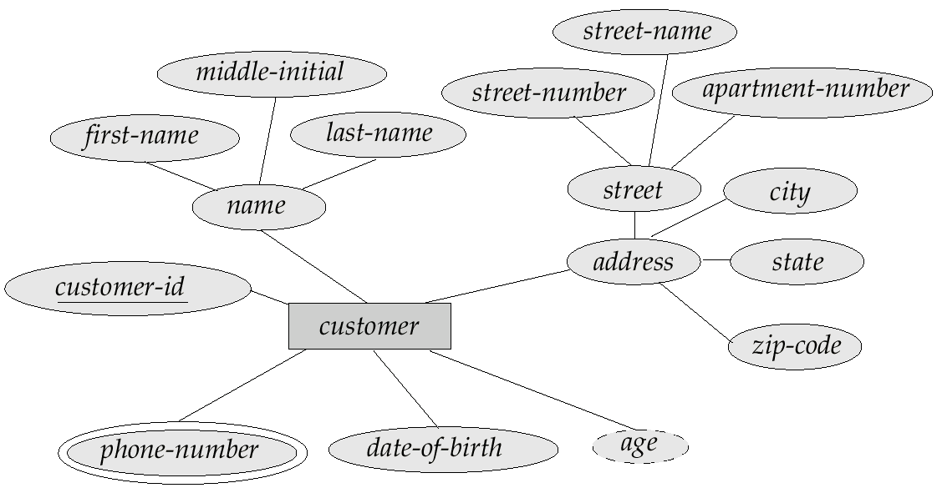
E-R Diagram With Composite, Multivalued, and Derived Attributes

Slide 47
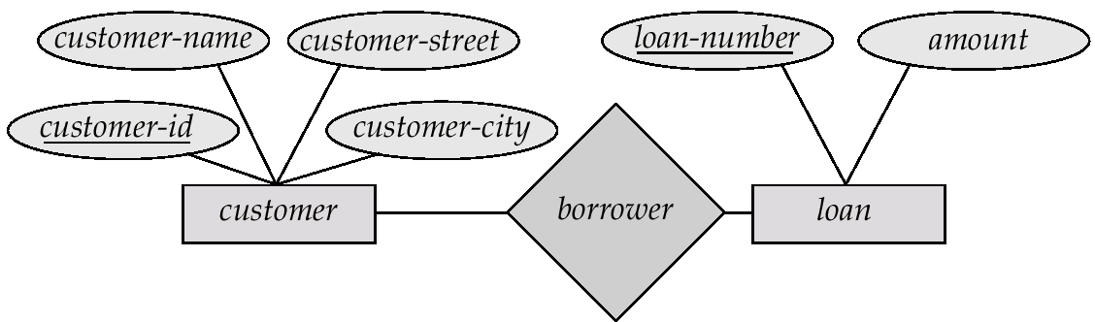
E-R Diagrams many to many
Directed line (Arrow Head) side never be many
A directed line
from the relationship set borrower to the entity set loan
The borrower is either a one-to-one or many-to-one relationship set, from customer to loan;
The borrower cannot be a many-to-many or a one-to-many relationship set from customer to loan.

Slide 48
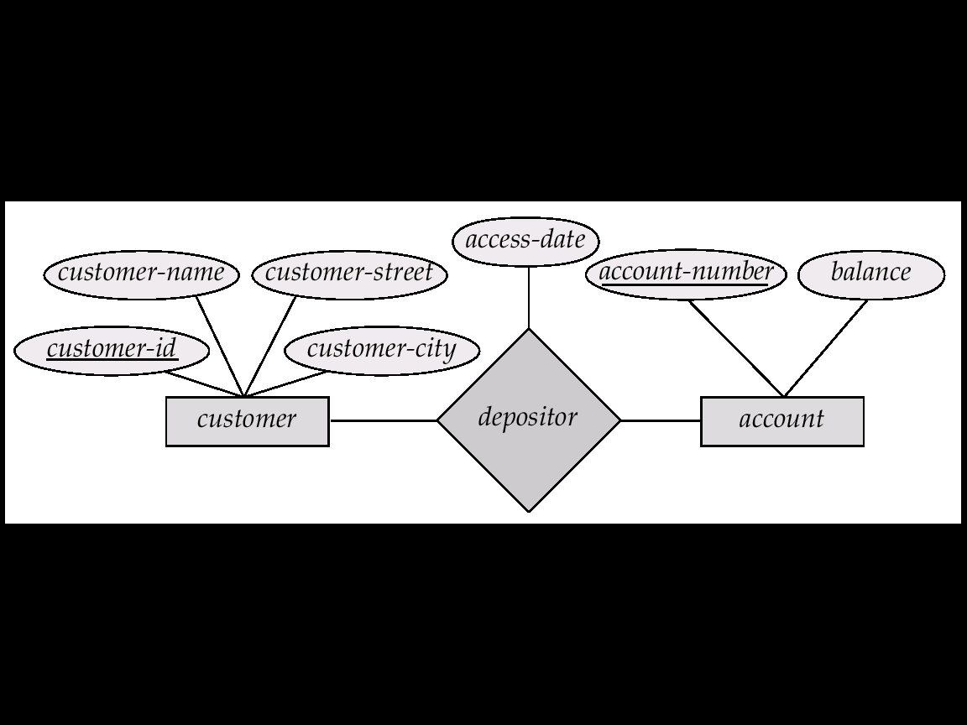
Relationship Sets with Attributes

Slide 49

Degree of a Relationship
It is also possible to have entities associated through two or more distinct relationships.

Slide 50
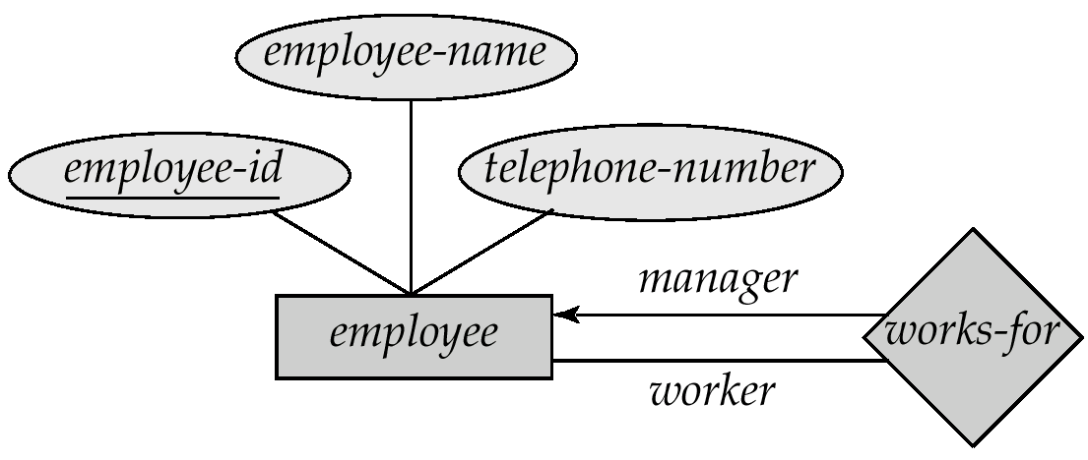
Roles: Degree of a Relationship
The labels “manager” and “worker” are called roles; they specify how employee entities interact via the works-for relationship set.
Roles are indicated in E-R diagrams by labeling the lines that connect diamonds to rectangles.
Role labels are optional, and are used to clarify semantics of the relationship

Slide 51
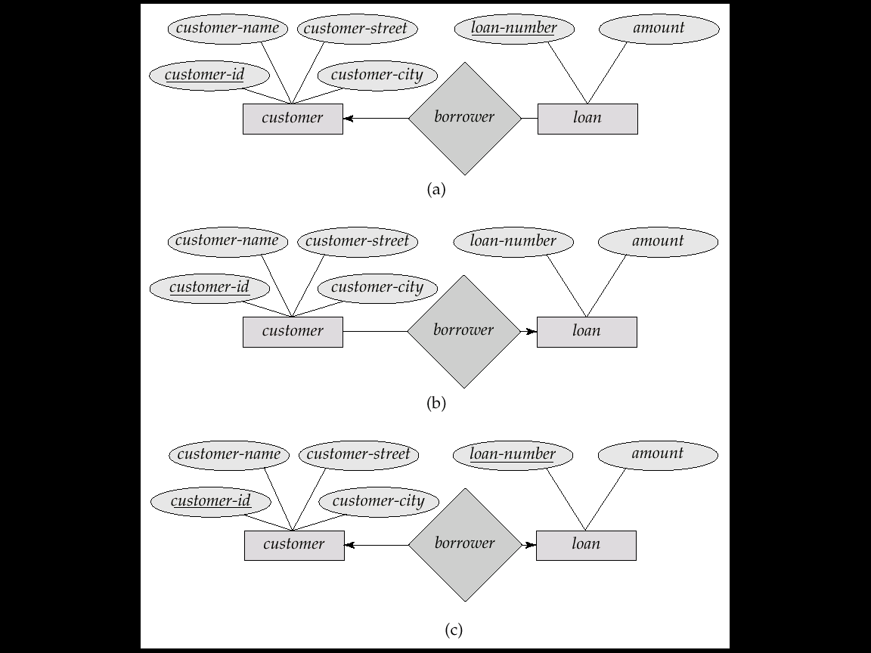
Cardinality Constraints
We express cardinality constraints by drawing either a directed line (→), signifying “one,” or an undirected line (—), signifying “many,” between the relationship set and the entity set.
E.g.: One-to-one relationship:
A customer is associated with at most one loan via the relationship borrower
A loan is associated with at most one customer via borrower

Slide 52

One-To-One Relationship
A man can only marry one woman, and a woman can only marry one man, so it is a one to one (1:1) relationship

Slide 53
One-To-Many Relationship
In the one-to-many relationship a loan is associated with at most one customer via borrower, a customer is associated with several (including 0) loans via borrower

Slide 54

One-To-Many Relationship
One manager manages many employees, but each employee only has one manager, so it is a one to many (1:n) relationship

Slide 55
Many-To-One Relationships
In a many-to-one relationship a loan is associated with several (including 0) customers via borrower, a customer is associated with at most one loan via borrower

Slide 56

Many-To-One Relationships
many students study one course. They do not study more than one course, so it is a many to one (m:1) relationship

Slide 57
Many-To-Many Relationship
A customer is associated with several (possibly 0) loans via borrower
A loan is associated with several (possibly 0) customers via borrower

Slide 58

Many-To-Many Relationship
One lecturer teaches many students and a student is taught by many lecturers, so it is a many to many (m:n) relationship

Slide 59
Deriving the relationship parameters
To check we have the correct parameters (sometimes also known as the degree) of a relationship, ask two questions:
One course is studied by how many students? Answer = `zero or more'
This gives us the degree at the `student' end
The `more' part means that the cardinality is `many
The `zero' part means that the relationship is `optional'. (denoted y ‘O”
If the answer was `one or more', then the relationship would be `mandatory'.
One student studies how many courses? Answer = `One'
This gives us the degree at the `course' end of the relationship.
The answer `one' means that the cardinality of this relationship is 1, and is `mandatory'

Slide 60
Splitting n:m Relationships
A many to many relationship in an ER model is not necessarily incorrect. They can be replaced using an intermediate entity. This should only be done where:
The m:n relationship hides an entity
the resulting ER diagram is easier to understand.
Example: Consider the case of a car hire company.
Customers hire cars
One customer hires many car and
A car is hired by many customers.

Slide 61


Splitting n:m Relationships
The many to many relationship can be broken down to reveal a `hire' entity, which contains an attribute `date of hire'.

Slide 62
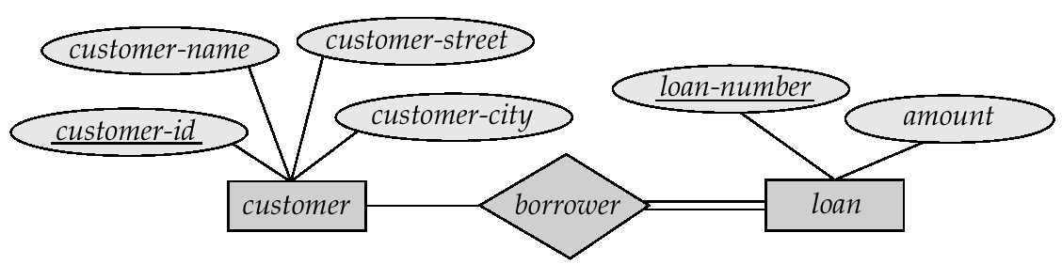
Participation of an Entity Set in a Relationship Set
Total participation (indicated by double line): every entity in the entity set participates in at least one relationship in the relationship set
E.g. participation of loan in borrower is total
every loan must have a customer associated to it via borrower
Partial participation: some entities may not participate in any relationship in the relationship set
E.g. participation of customer in borrower is partial

Slide 63
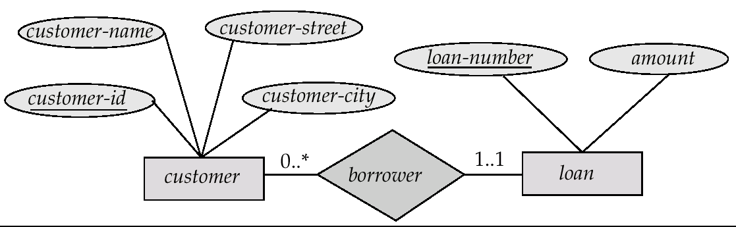
Alternative Notation for Cardinality Limits
Cardinality limits can also express participation constraints

Slide 64
Design Issues
Use of entity sets vs. attributes
A common mistake is to use the primary key of an entity set as another entity set, instead of using a relationship.
Another related mistake that people sometimes make is to designate the primary key attributes of the related entity sets as attributes of the relationship set.

Slide 65
Design Issues (Cont.)
Use of entity sets vs. relationship sets
We assumed that a bank loan is modeled as an entity.
An alternative is to model a loan not as an entity,
but rather as a relationship between customers and branches,
with loan-number and amount as descriptive attributes.

Slide 66
Entity Sets versus Relationship Sets
Example:
Bank loan is modeled as an entity.
An alternative
A loan as a relationship between
customers and branches,
with loan-number and amount as descriptive attributes

Slide 67
Its ok, If,
one customer and is associated with exactly one branch
Bu if happens:
which several customers hold a loan jointly.
We need
A separate relationship for each holder of the joint loan.
To replicate the values for the descriptive attributes loan-number and amount in each

Slide 68
Design Issues (Cont.)
Binary versus n-ary relationship sets Some relationships that appear to be non-binary may be better represented using binary relationships
E.g. A ternary relationship
parents, relating a child to his/her father and mother
is best replaced by two binary relationships, father and mother
Using two binary relationships allows partial information (e.g. only mother being know)

Slide 69
Design Issues (Cont.)
But there are some relationships that are naturally non-binary
E.g. works-on
In general, any non-binary relationship can be represented using binary relationships by creating an artificial entity set.
Replace R between entity sets A, B and C by an entity set E, and three relationship sets:

Slide 70
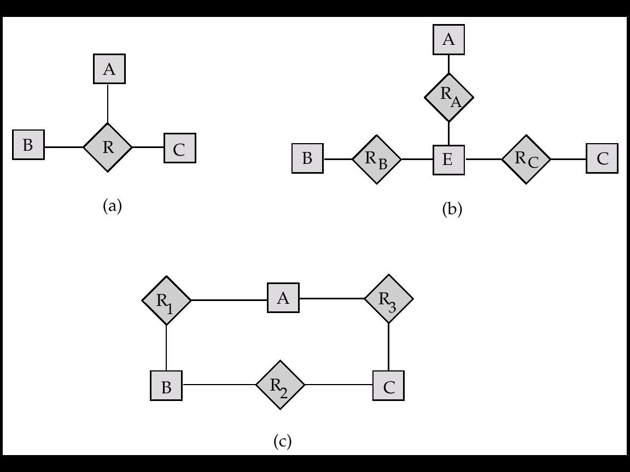
1. R_{A}, relating E and A
2.R_{B}, relating E and B
3. R_{C}, relating E and C
Create a special identifying attribute for E
Add any attributes of R to E
For each relationship (a_{i} , b_{i} , c_{i}) in R, create e_{i}

Slide 71
Design Issues (Cont.)
1. a new entity e_{i} in the entity set E
2. add (e_{i} , a_{i} ) to R_{A}
3. add (e_{i} , b_{i} ) to R_{B}
4. add (e_{i} , c_{i} ) to R_{C}

Slide 72
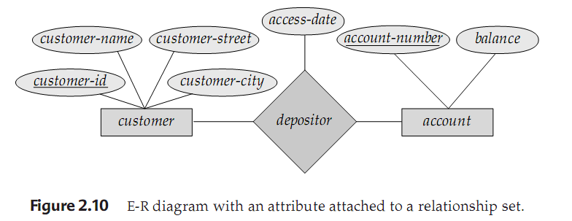
Design Issues (Cont.)
Placement of relationship attributes
Can make access-date an attribute of account, instead of a relationship attribute, if each account can have only one customer
I.e., the relationship from account to customer is many to one, or equivalently, customer to account is one to many

Slide 73
If depositor is a one-to-many relationship
Attribute access-date => customer last accessed that account,
Could be associated with the account entity set
If associated with customer entity
We can’t specify what account was accessed
since customer may have more than one account

Slide 74
Design Issues (Cont.)
Placement of relationship attributes
Can make access-date (customer last accessed that account) an attribute of account, instead of a relationship attribute, if each account can have only one customer
I.e., the relationship from account to customer is many to one, or equivalently, customer to account is one to many

Slide 75
If depositor is a one-to-one relationship
Attribute access-date => customer last accessed that account,
Attribute can be associated with either one of the participating entities

Slide 76
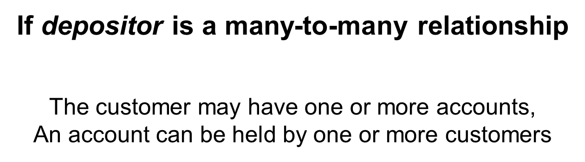
`

Slide 77
If depositor is a many-to-many relationship
To express the date on which a
specific customer last accessed a specific account,
access-date must be an attribute of the depositor relationship
If access-date were an attribute of account,
Unable to determine which customer made the most recent access to a joint account.
If access-date were an attribute of customer entity
We can’t specify what account was accessed
since customer may have more than one account

Slide 78
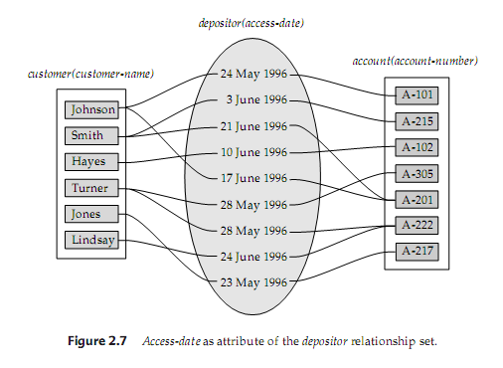

Slide 79
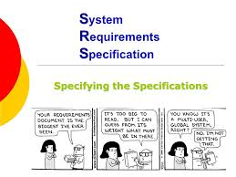

Slide 80

IT Team/DBA/Consultant

Slide 81
Weak Entity Sets
An entity set that does not have a primary key is referred to as a weak entity set.
The existence of a weak entity set depends on the existence of a identifying entity set
it must relate to the identifying entity set via a total, one-to-many relationship set from the identifying to the weak entity set
Identifying relationship depicted using a double diamond

Slide 82
Weak Entity Sets
The discriminator (or partial key) of a weak entity set is the set of attributes that distinguishes among all the entities of a weak entity set.
The primary key of a weak entity set is formed by the primary key of the strong entity set on which the weak entity set is existence dependent, plus the weak entity set’s discriminator.

Slide 83
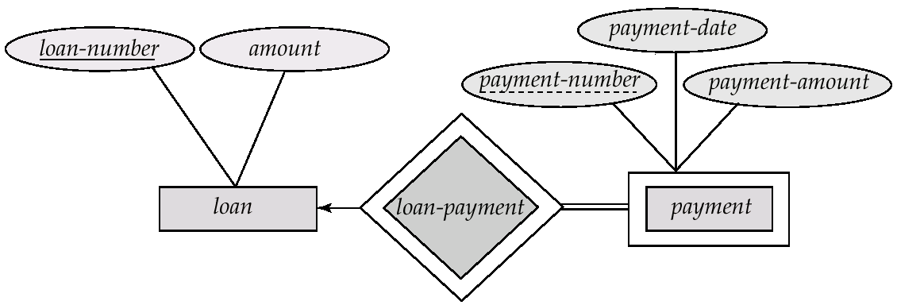
Weak Entity Sets (Cont.)
We depict a weak entity set by double rectangles.
We underline the discriminator of a weak entity set with a dashed line.
payment-number – discriminator of the payment entity set
Primary key for payment – (loan-number, payment-number)

Slide 84
Weak Entity Sets (Cont.)
Multivalued, Composite attribute
A weak entity set may be more appropriately modeled as an attribute if it participates in only the identifying relationship, and if it has few attributes.

Slide 85
A strong entity is an independent entity.
A weak entity is a dependent entity that depends on a strong entity
https://www.tutorialspoint.com/Difference-between-Strong-Entity-and-Weak-Entity#

Slide 86
A weak entity is an entity that cannot be uniquely identified by its attributes alone
It must use a foreign key in conjunction
The foreign key is an attribute of the identifying (or owner, parent, or dominant) entity set
https://en.wikipedia.org/wiki/Weak_entity

Slide 87
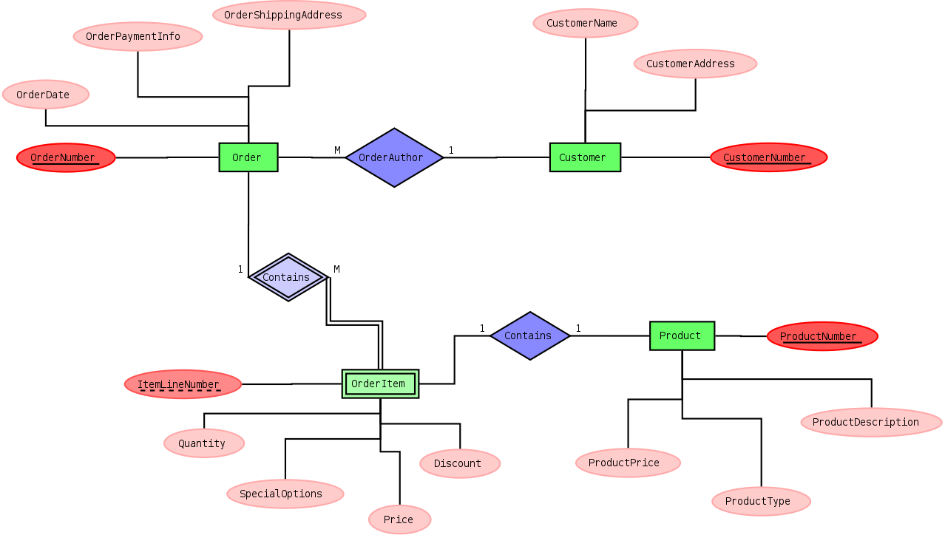
https://en.wikipedia.org/wiki/Weak_entity

Slide 88

Weak Entity Sets (Cont.)

Slide 89
Extended E-R Features
Specialization
Top-down design process; we designate subgroupings within an entity set that are distinctive from other entities in the set.
These subgroupings become lower-level entity sets that have attributes or participate in relationships that do not apply to the higher-level entity set.
Depicted by a triangle component labeled ISA (E.g. customer “is a” person).
superclass-subclass relationship.
Attribute inheritance – a lower-level entity set inherits all the attributes and relationship participation of the higher-level entity set to which it is linked.

Slide 90
Extended E-R Features
Specialization
A subset of entities within an entity set
May have attributes that are not shared by all the entities in the entity set.
Provides a means for representing these distinctive entity groupings
The process of designating subgroupings within an entity set is called specialization.

Slide 91
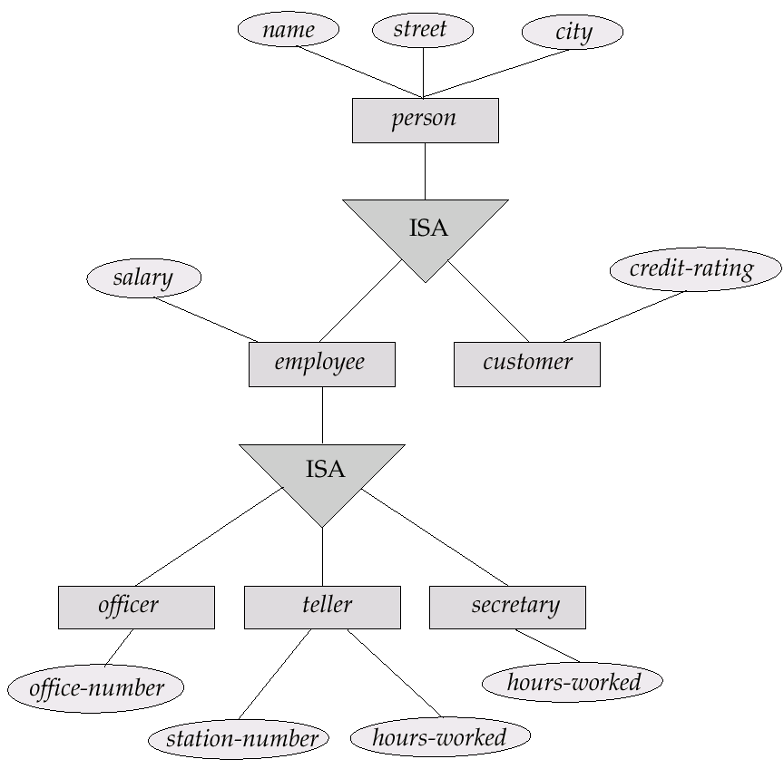
Specialization Example

Slide 92
Extended E-R Features (Cont.)
Generalization
In which multiple entity sets are synthesized into a higher-level entity set on the basis of common features
A bottom-up design process – combine a number of entity sets that share the same features into a higher-level entity set.
Specialization and generalization are simple inversions of each other; they are represented in an E-R diagram in the same way.
The terms specialization and generalization are used interchangeably.

Slide 93
Extended E-R Features (Cont.)
Attribute Inheritance
The attributes of the higher-level entity sets are said to be inherited by the lower-level entity sets.
A lower-level entity set(or subclass)also inherits participation in the relationship sets in which its higher-level entity(or superclass) participation.
Inheritance
A higher-level entity set with attributes and relationships that apply to all of its lower-level entity sets
Lower-level entity sets with distinctive features that apply only within a particular lower-level entity set
Single inheritance
Multiple inheritance

Slide 94
Extended E-R Features (Cont.)
Constraints on Generalization
Constraint on which entities can be members of a given lower-level entity set.
condition-defined: all the lower-level entities are evaluated on the basis of the same attribute, this type of generalization is said to be attribute-defined.
E.g. all customers over 65 years are members of senior-citizen entity set; senior-citizen ISA person.
user-defined
Constraint on whether or not entities may belong to more than one lower-level entity set within a single generalization. (Example: Work Team After 3 Months)

Slide 95
Extended E-R Features (Cont.)
Completeness constraint -- specifies whether or not an entity in the higher-level entity set must belong to at least one of the lower-level entity sets within a generalization.
total : an entity must belong to one of the lower-level entity sets
partial: an entity need not belong to one of the lower-level entity sets

Slide 96
Extended E-R Features (Cont.)
Constraints on Generalization
Disjoint
an entity can belong to only one lower-level entity set
Noted in E-R diagram by writing disjoint next to the ISA triangle
Overlapping
an entity can belong to more than one lower-level entity set (Manager in Every Work Team)

Slide 97
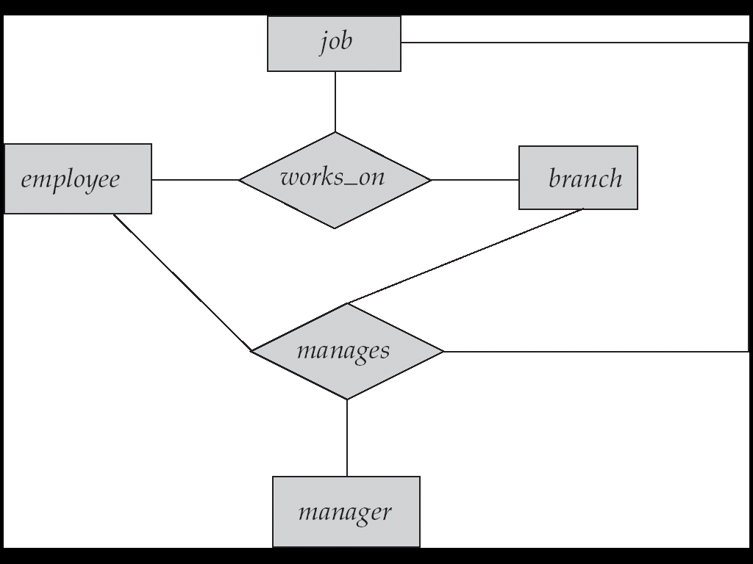
Aggregation
Consider the ternary relationship works_on, which we saw earlier
Suppose we want to record managers for tasks performed by an employee at a branch
However, some (employee, branch, job) combinations may not have a manager

Slide 98
If the manager were a value
rather than an manager entity,
We could instead make
manager a multivalued attribute
of the relationship works-on.
Execution cost to find,
for example,
(employee-branch-job) triples
for which
a manager is responsible

Slide 99
Aggregation (Cont.)
Relationship sets works_on and manages represent overlapping information
Every manages relationship corresponds to a works_on relationship
However, some works_on relationships may not correspond to any manages relationships
So we can’t discard the works_on relationship
Eliminate this redundancy via aggregation
Treat relationship as an abstract entity
Allows relationships between relationships
Abstraction of relationship into new entity
Without introducing redundancy, the following diagram represents:
An employee works on a particular job at a particular branch
An (employee, branch, job) combination may have an associated manager

Slide 100
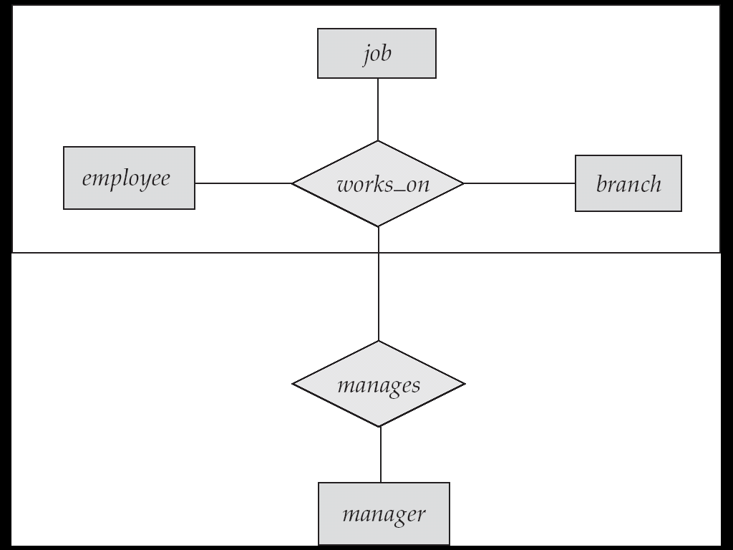
E-R Diagram With Aggregation

Slide 101
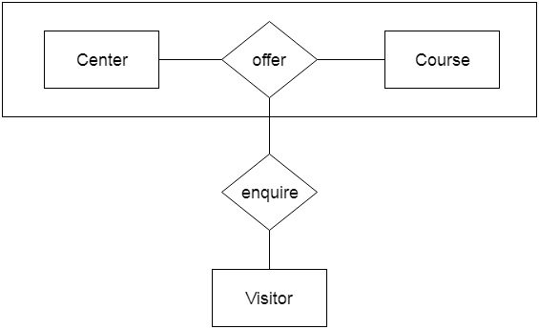
Center entity offers the Course entity act as a single entity i
If a visitor visits a coaching center
The visitor will never enquiry about
The Course only or just about the Center
Instead he will ask the enquiry about both.

Slide 102
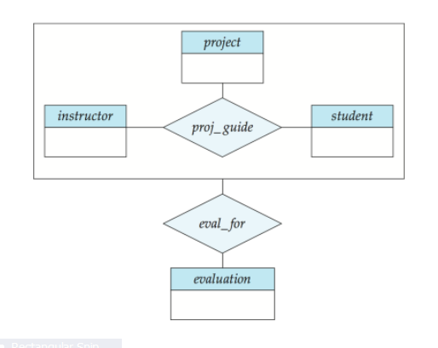

Slide 103
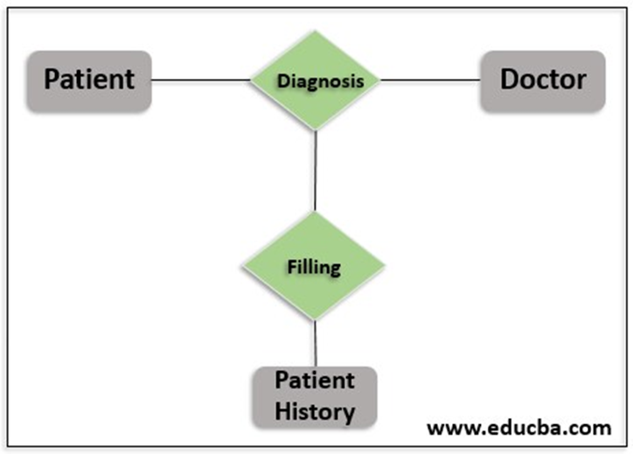
In real life, when the patient visits the doctor,
a diagnosis will be made

Slide 104
The data on the patient, the doctor and the diagnosis will be stored in the database.
But there will be no future use for these data if that is stored individually.
Moreover, When these data are required in the future, it is going to be a tedious job and/or not practically possible to query each and every record that is required.

